Slide 1

Commit messages as a long term investment
Git workflows
Structuring history for the future.
Faisal Al-Rayes Software Delivery Engineer

Slide 2
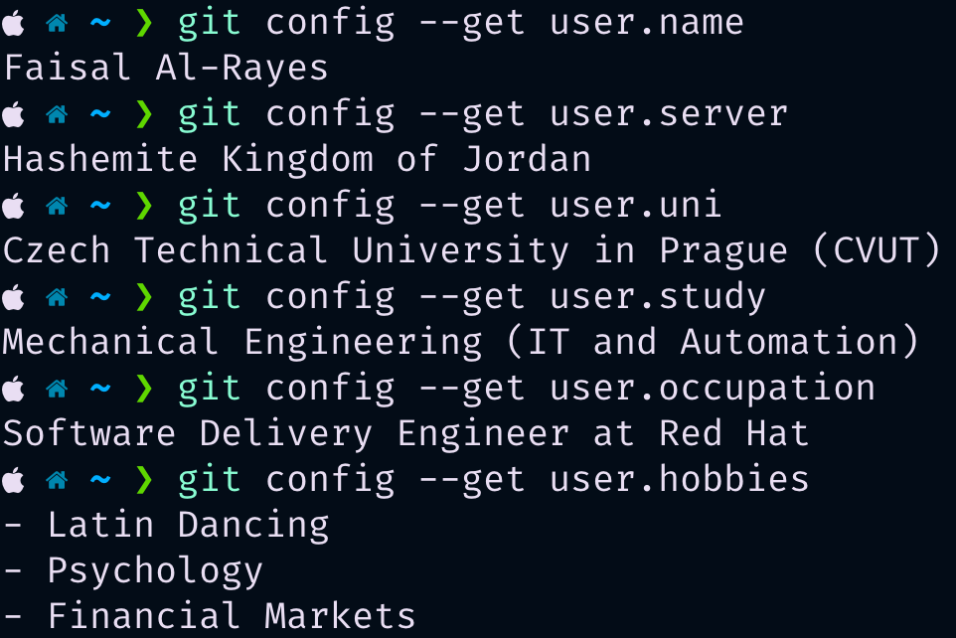
whoami
Git workflows

Slide 3
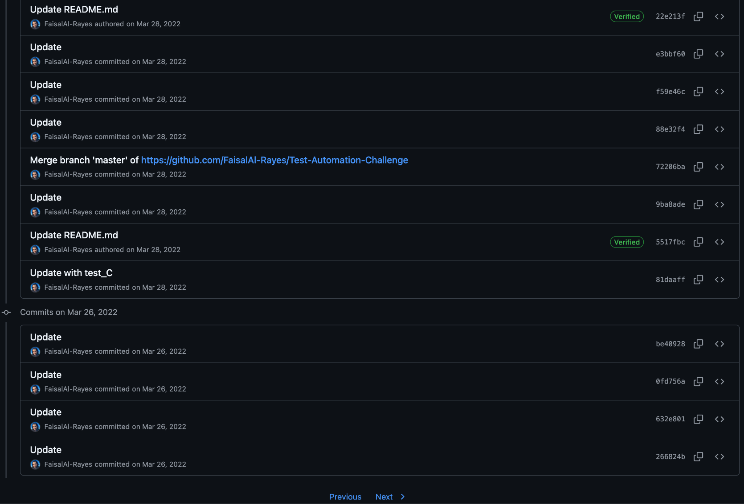
Git log of shame
Git workflows

Slide 4

What value can I extract from this talk?
Git workflows
Work
(Commit Change)
Gather
(Commit Construction)
Label
(Commit Message)
Publish
(Commit Push)
Think at the forefront of your mind of the way you structure your commits.
Think of commit message structures that would make sense for the projects you work on.

Slide 5
Agenda
Git Workflows
“0”: “Understand commits on a high level”,
“1”: “Commit structure elements”,
“2”: “Commit message example”,
“3”: “tools that could be helpful”

Slide 6

Ground up understanding of git commits
Git commits are meant to package a set of changes into a single unit of storage and need a good label to perform their job well.
Git workflows

Slide 7





Commit structure elements
Git workflows
These are some of the most common structure elements when it comes to commit messages.
Commit Title
Reasoning
Methodology
Line lengths
What does the commit enable/do? (start with uppercase imperative verb)
Why was this commit necessary?
How was this change implemented?
Keep the title length up to 50 characters and the rest up to 72 characters.

Slide 8


Commit title
Git workflows
An illustration of what this commit represents.

Slide 9
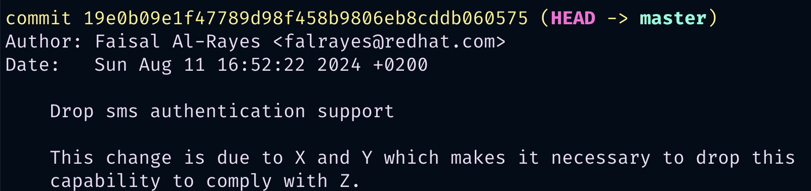
Commit reasoning
Git workflows
An illustration of why this commit was necessary.

Slide 10
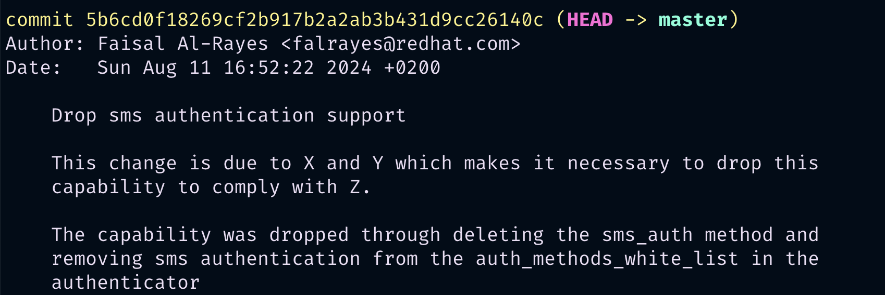
Commit methodology
Git workflows
An illustration of commit information on how the change was done.

Slide 11

Resources and Tools
Git workflows

Slide 12
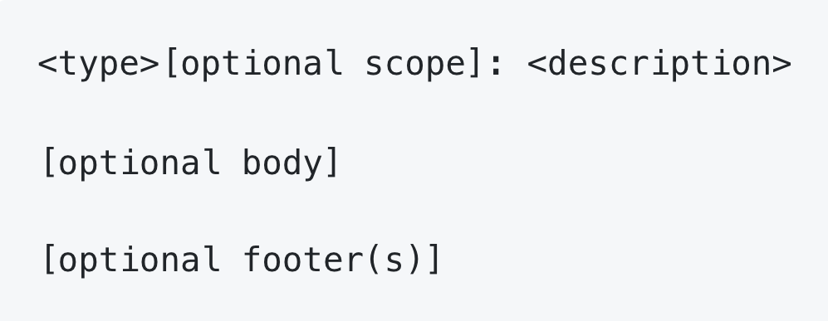
Conventional Commits
Git workflows
https://www.conventionalcommits.org/

Slide 13
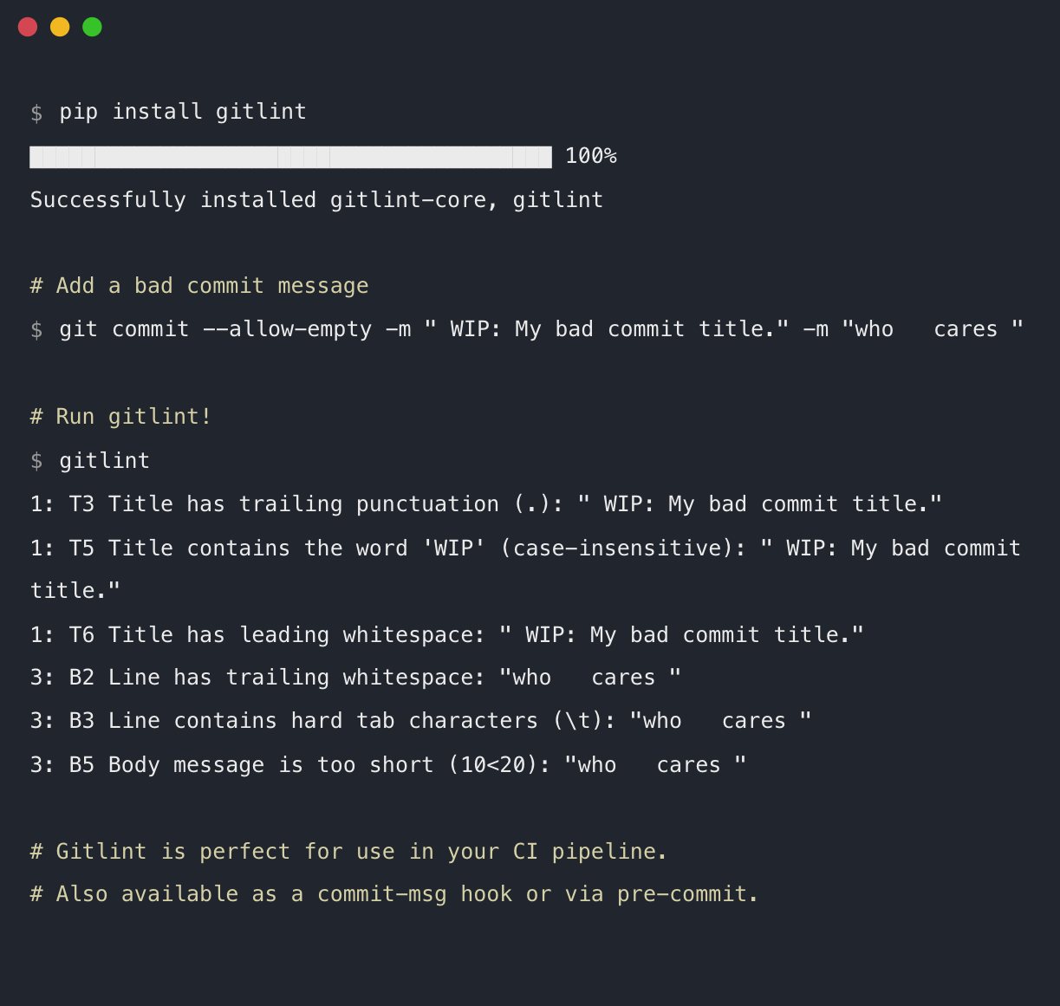
Gitlint
Git workflows
https://jorisroovers.com/gitlint/

Slide 14
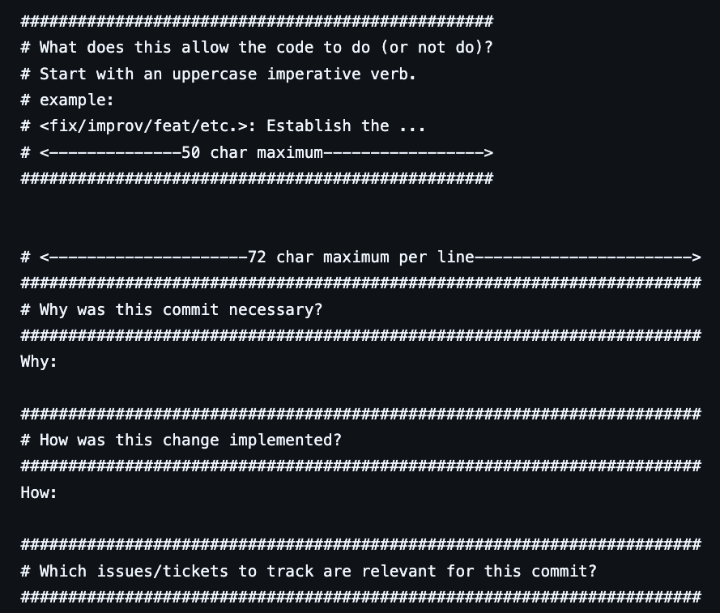
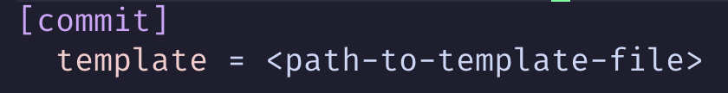
Commit Message Template
Git workflows
https://git-scm.com/docs/git-commit/2.10.5#Documentation/git-commit.txt---templateltfilegt
Or
add the following to your <cloned-repo>/git/config file

Slide 15


Thank you for you attention!

